Slide 1
Chapter 1: Exploring the Network
Introduction to Networks
Notes:
Cisco Networking Academy program
Introduction to Networks
Chapter 1: Exploring the Network

Slide 2
Chapter 1: Objectives
Students will be able to:
Explain how multiple networks are used in everyday life.
Explain the topologies and devices used in a small to medium-sized business network.
Explain the basic characteristics of a network that supports communication in a small to medium-sized business.
Explain trends in networking that will affect the use of networks in small to medium-sized businesses.
Notes:
2

Slide 3
Chapter 1
1.1 Globally Connected
1.2 LANs, WANs, and the Internet
1.3 The Network as a Platform
1.4 The Changing Network Environment
1.5 Summary
Notes:
Chapter 1 Sections

Slide 4
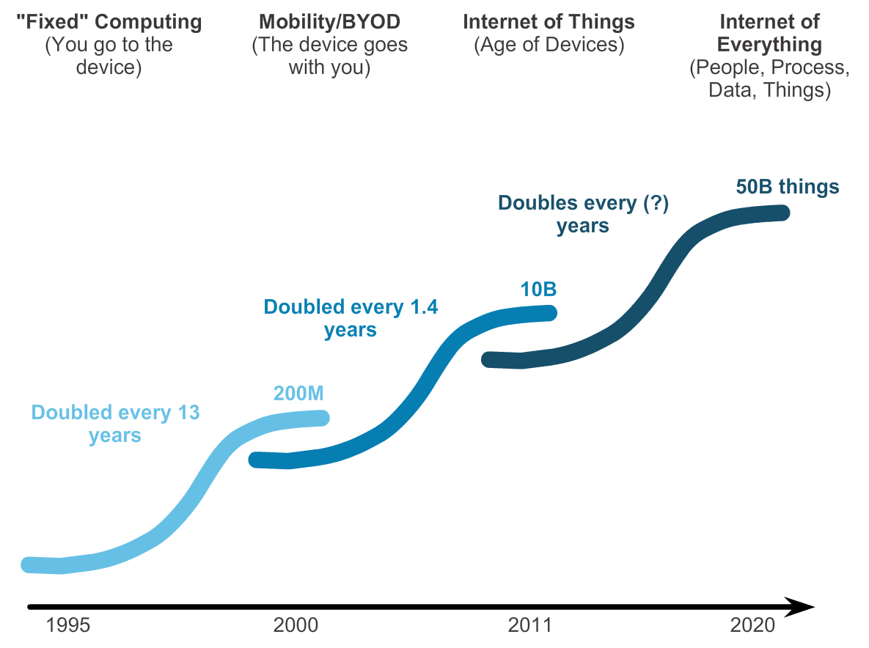
Networking Today Networks in Our Past and Daily Lives
Notes:
Section 1.1.1.1 & 1.1.1.2

Slide 5
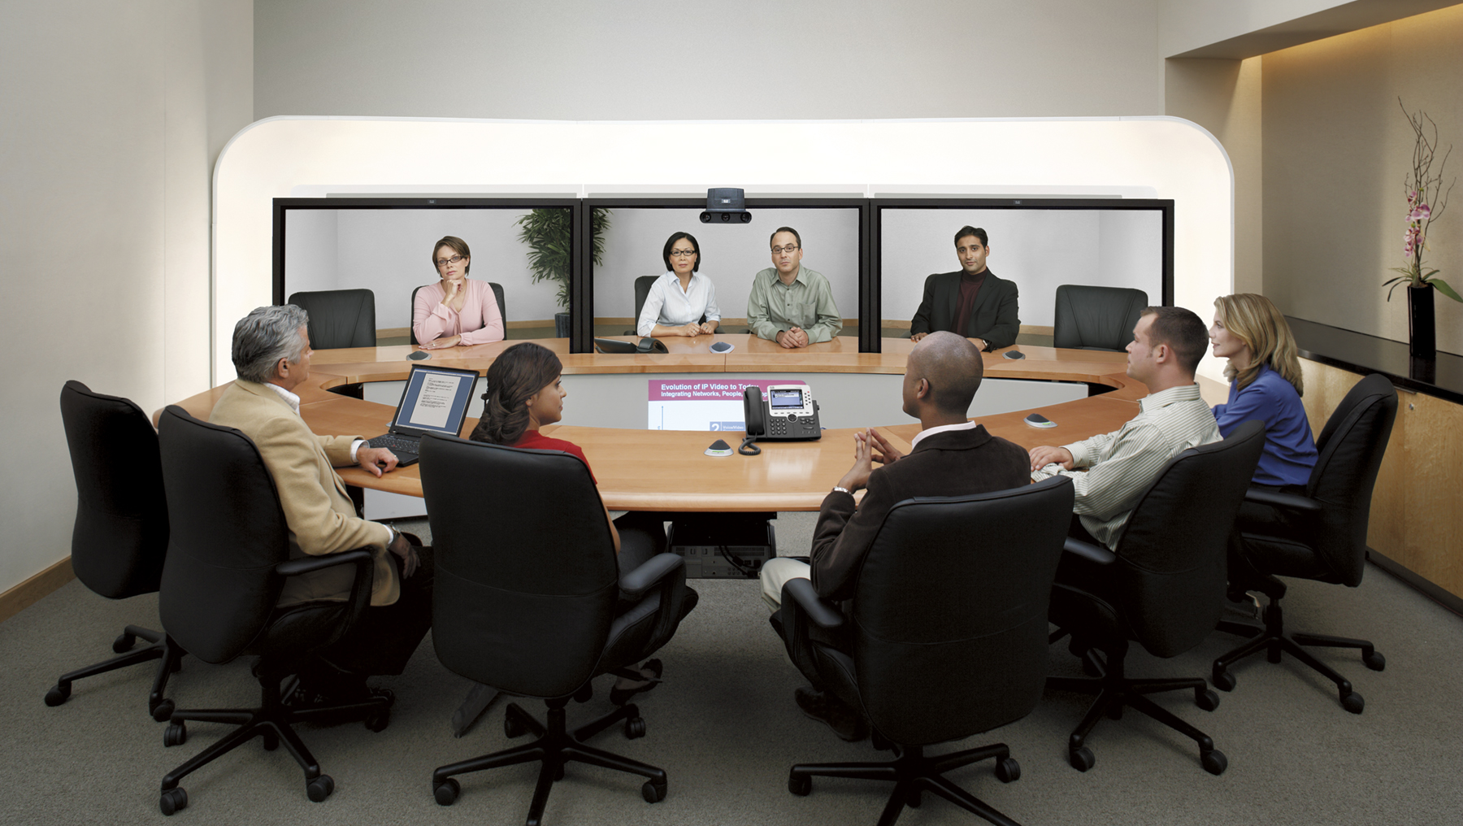
Networking Today The Global Community
Notes:
Section 1.1.1.3

Slide 6
Interconnecting our Lives Networking impacts in our daily lives
Networks Support the Way We Learn
Networks Support the Way We Communicate
Networks Support the Way We Work
Networks Support the Way We Play
Notes:
Section 1.1.1.4, 1.1.1.5, 1.1.1.6 & 1.1.1.7

Slide 7
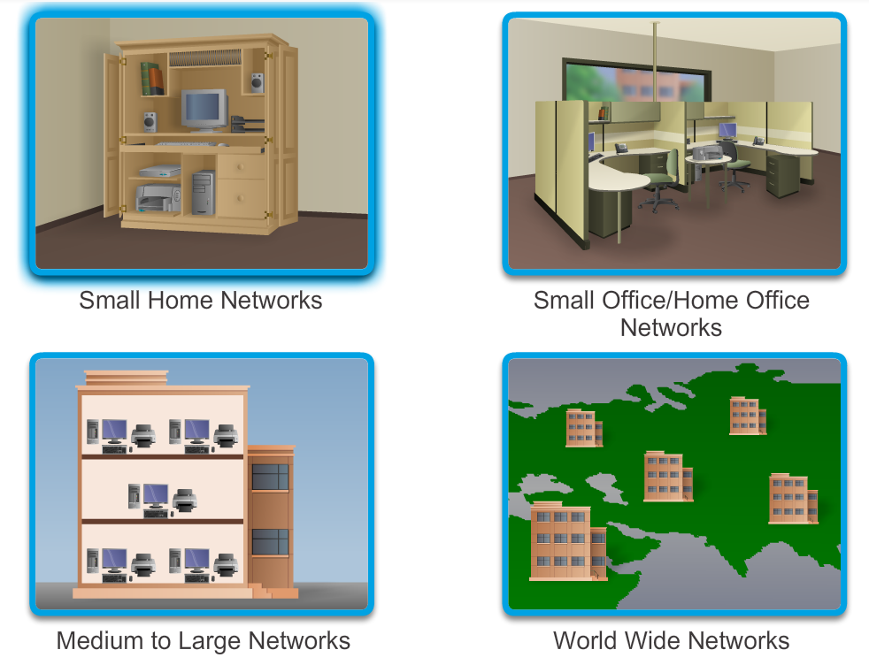
Providing Resources in a Network Networks of Many Sizes
Notes:
Section 1.1.2.1

Slide 8
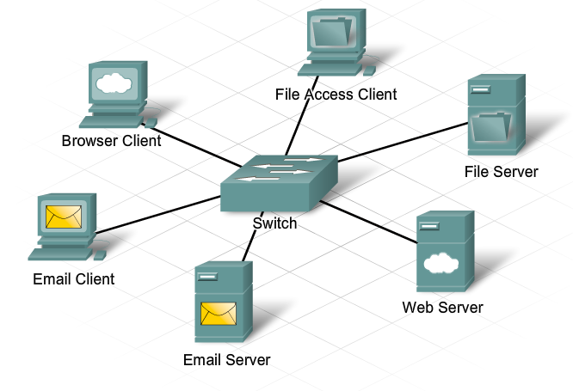
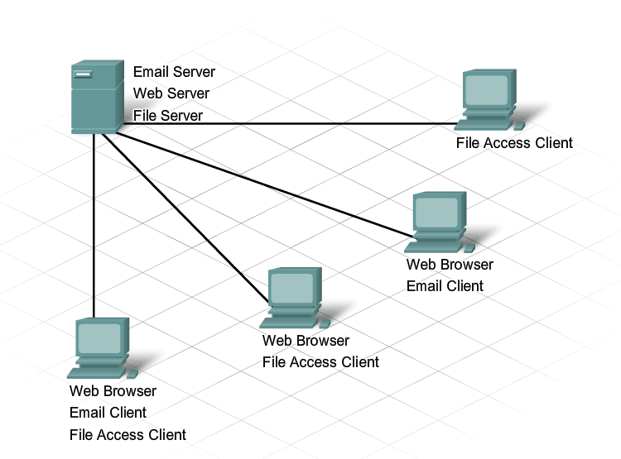
Providing Resources in a Network Clients and Servers
Notes:
Section 1.1.2.2 & 1.1.2.3

Slide 9
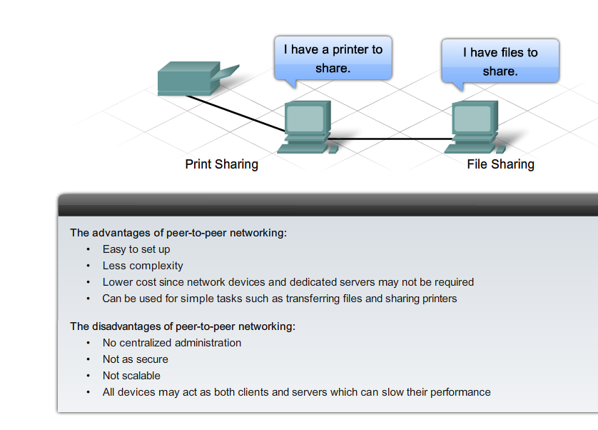
Providing Resources in a Network Peer-to-Peer
Notes:
Section 1.1.2.4

Slide 10
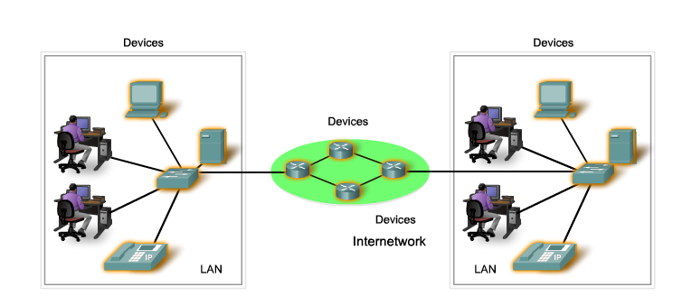
LANs, WANs, and Internets Components of a Network
There are three categories of network components:
Devices
Media
Services
Notes:
Section 1.2.1.1

Slide 11
Components of a Network End Devices
Some examples of end devices are:
Computers (work stations, laptops, file servers, web servers)
Network printers
VoIP phones
TelePresence endpoint
Security cameras
Mobile handheld devices (such as smartphones, tablets, PDAs, and wireless debit / credit card readers and barcode scanners)
Notes:
Section 1.2.1.2

Slide 12
Components of a Network Network Infrastructure Devices
Examples of intermediary network devices are:
Network Access Devices (switches, and wireless access points)
Internetworking Devices (routers)
Security Devices (firewalls)
Notes:
Section 1.2.1.3

Slide 13
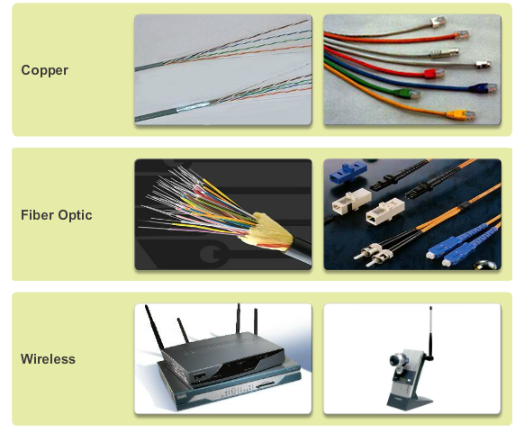
Components of a Network Network Media
Notes:
Section 1.2.1.4

Slide 14
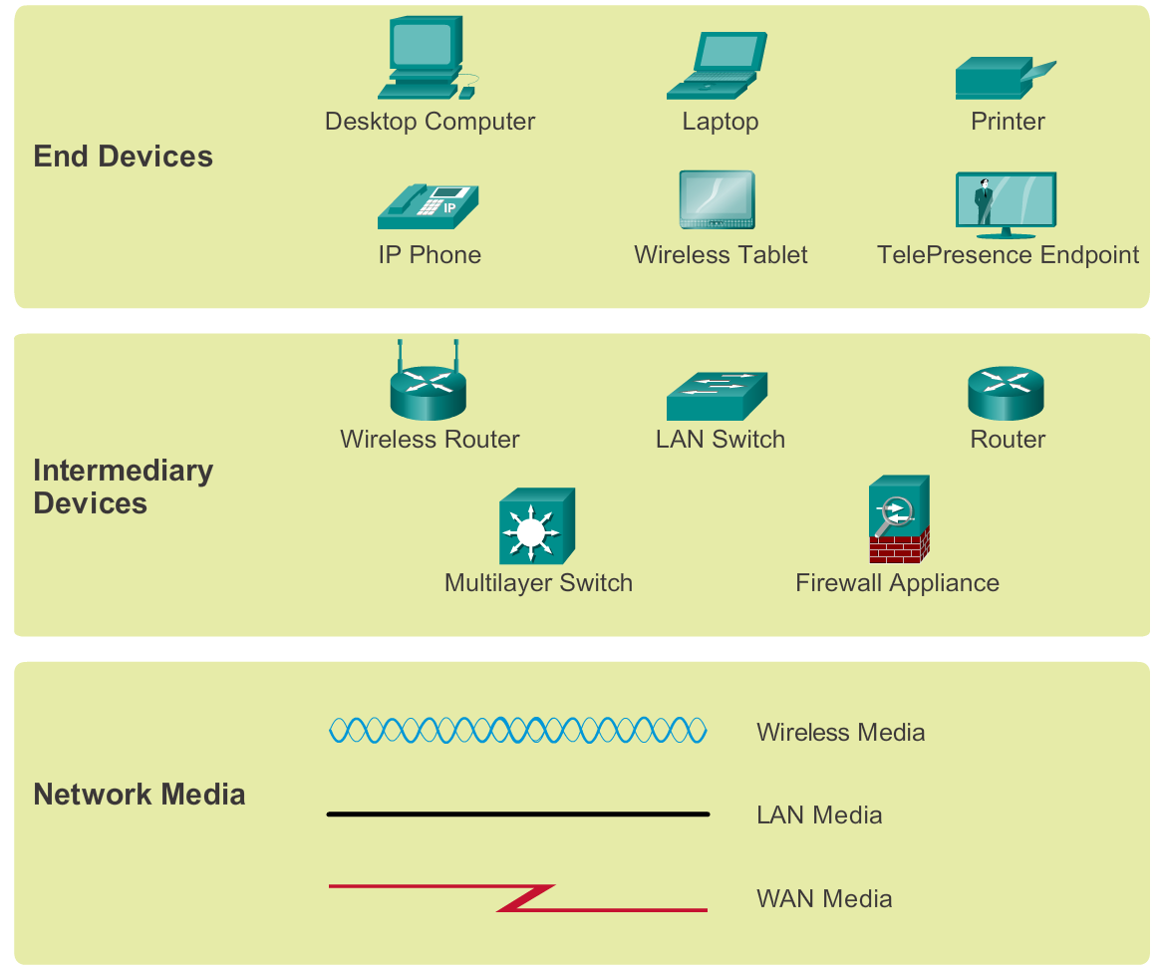
Components of a Network Network Representations
Notes:
Section 1.2.1.5

Slide 15
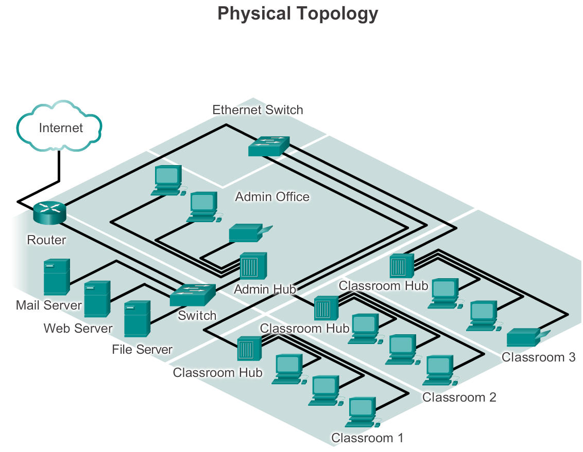
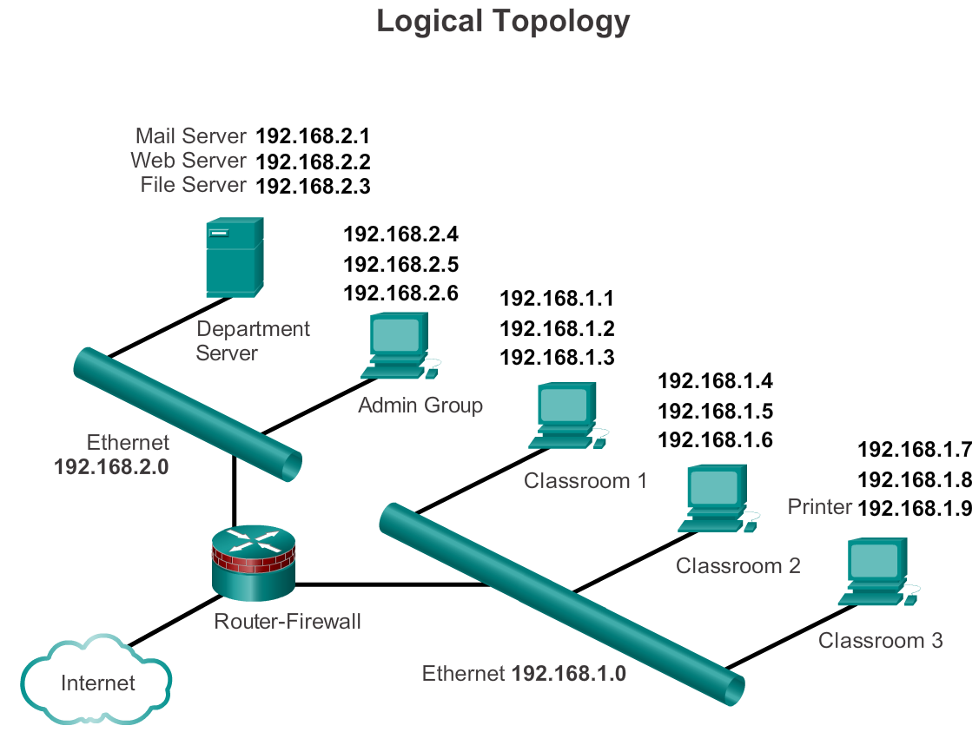
Components of a Network Topology Diagrams
Notes:
Section 1.2.1.6

Slide 16
LANs and WANs Types of Networks
The two most common types of network infrastructures are:
Local Area Network (LAN)
Wide Area Network (WAN).
Other types of networks include:
Metropolitan Area Network (MAN)
Wireless LAN (WLAN)
Storage Area Network (SAN)
Notes:
Section 1.2.2.1

Slide 17
LANs and WANs Local Area Networks (LAN)
Notes:
Section 1.2.2.2

Slide 18
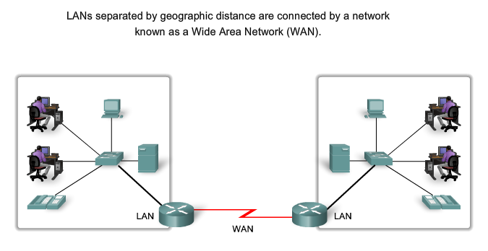
LANs and WANs Wide Area Networks (WAN)
Notes:
Section 1.2.2.3

Slide 19
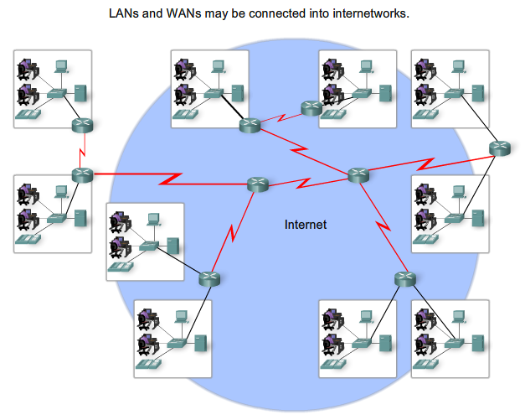
LANs, WANs, and Internets The Internet
Notes:
Section 1.2.3 & 1.2.3.1

Slide 20
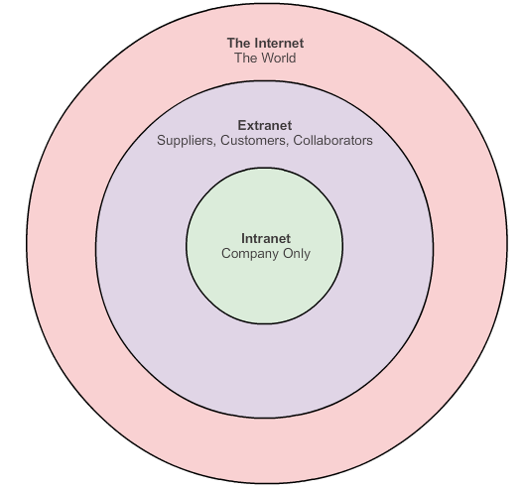
The Internet Intranet and Extranet
Notes:
Section 1.2.3.2

Slide 21
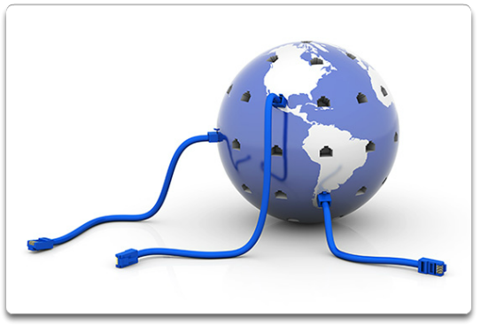
LANs, WANs, and Internets Internet Access Technologies
Notes:
Section 1.2.4.1

Slide 22
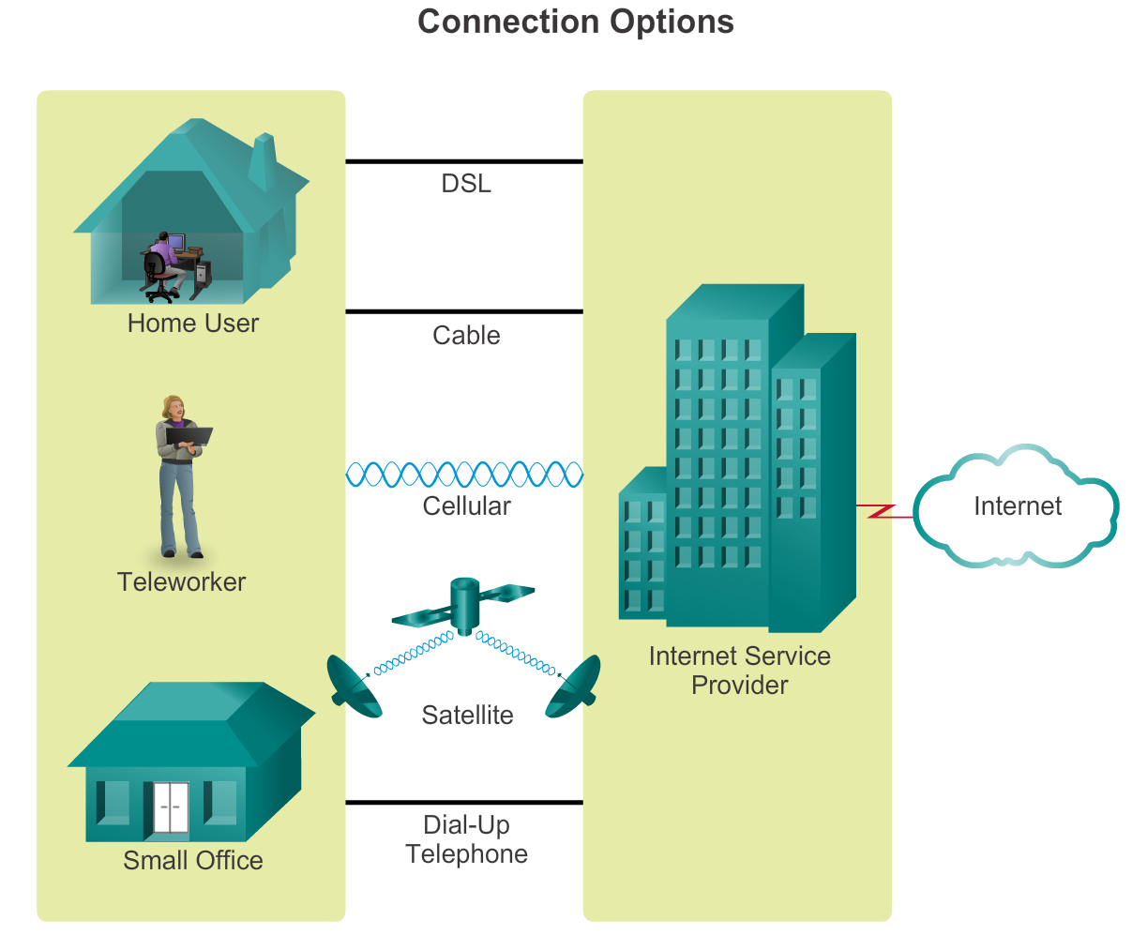
Connecting to the Internet Connecting Remote Users to the Internet
Notes:
Section 1.2.4.2

Slide 23
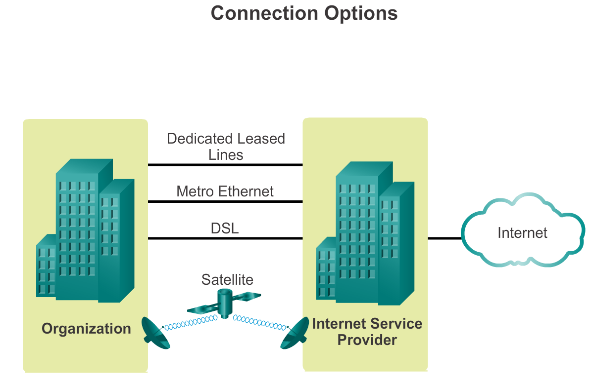
Connecting to the Internet Connecting Businesses to the Internet
Notes:
Section 1.2.4.3

Slide 24
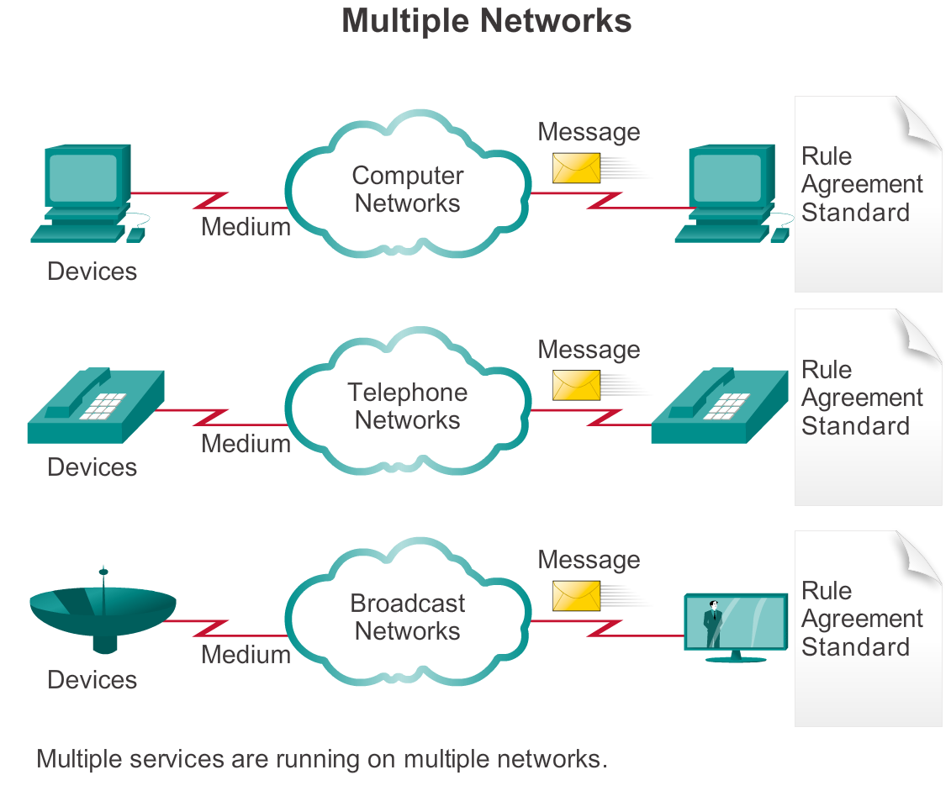
Converged Networks The Converging Network
Notes:
Section 1.3.1.1

Slide 25
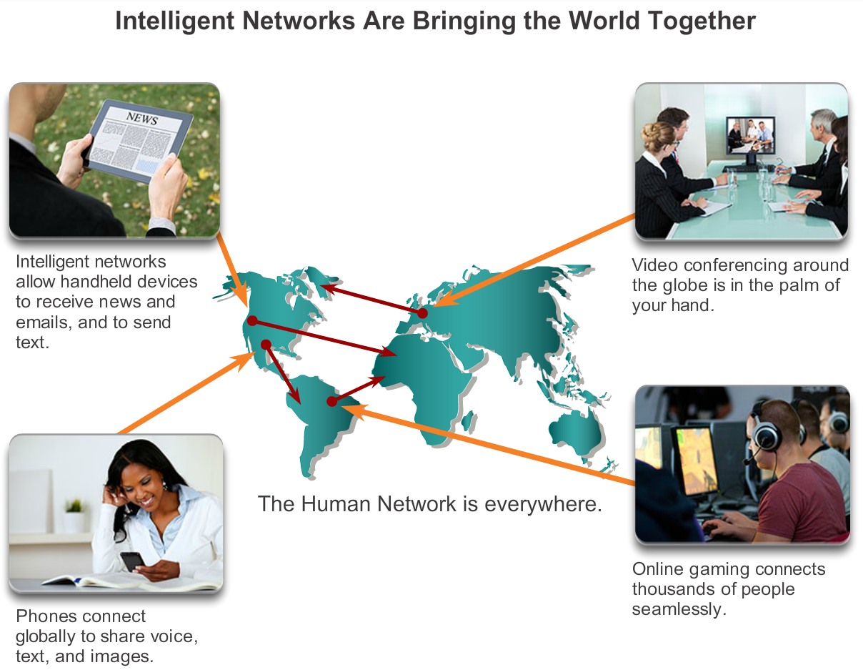
Converged Networks Planning for the Future
Notes:
Section 1.3.1.2

Slide 26
Reliable Network Supporting Network Architecture
As networks evolve, we are discovering that there are four basic characteristics that the underlying architectures need to address in order to meet user expectations:
Fault Tolerance
Scalability
Quality of Service (QoS)
Security
Notes:
Section 1.3.2.1

Slide 27
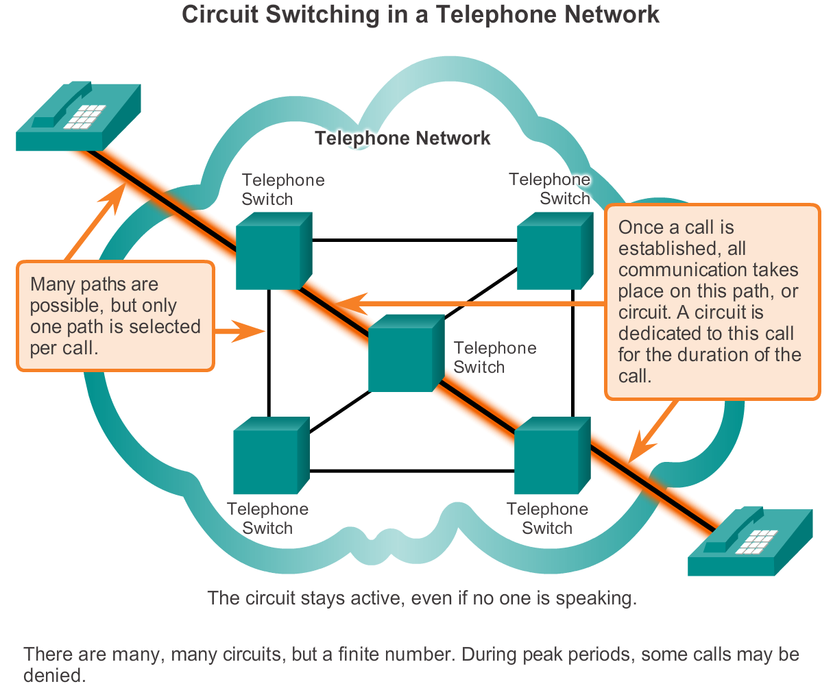
Reliable Network Fault Tolerance in Circuit Switched Network
Notes:
Section 1.3.2.2

Slide 28
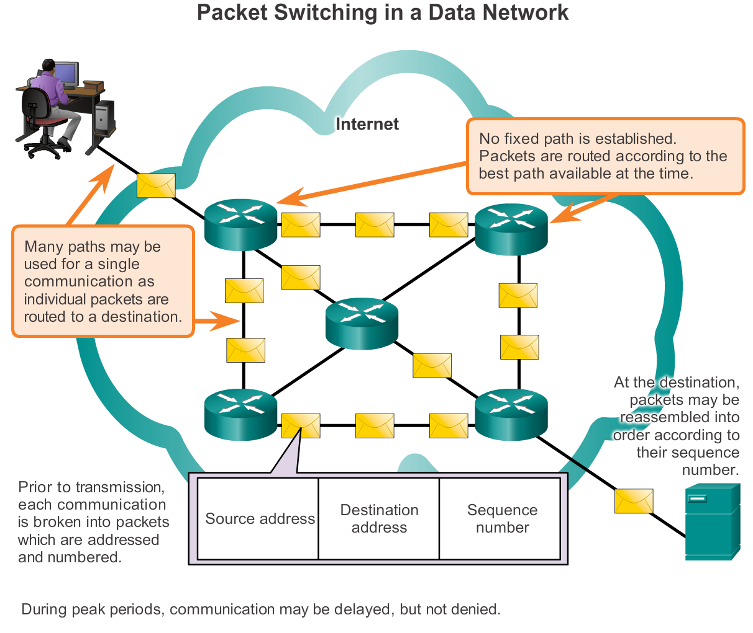
Reliable Network Packet-Switched Networks
Notes:
Section 1.3.2.3

Slide 29
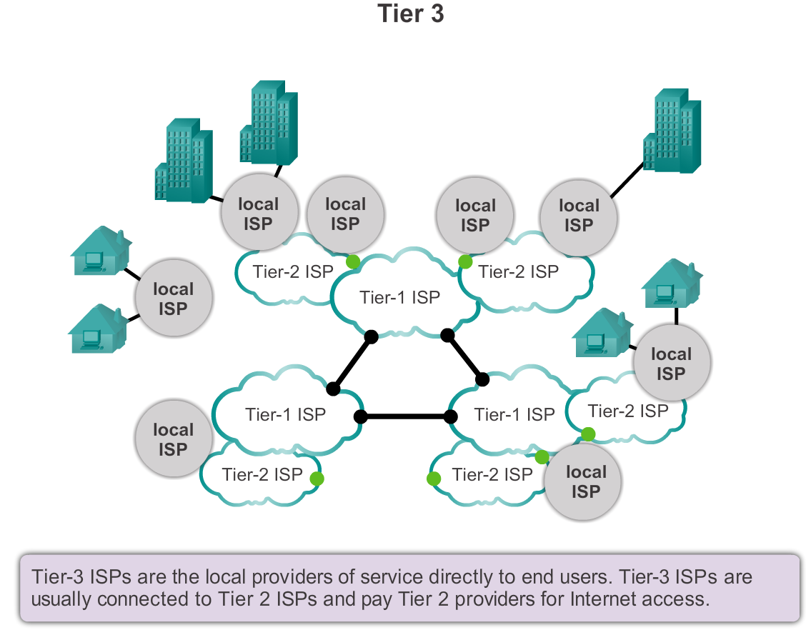
Reliable Network Scalable Networks
Notes:
Section 1.3.2.4

Slide 30
Reliable Network Providing (QoS)
Examples of priority decisions for an organization might include:
Time-sensitive communication - increase priority for services like telephony or video distribution.
Non time-sensitive communication - decrease priority for web page retrieval or email.
High importance to organization - increase priority for production control or business transaction data.
Undesirable communication - decrease priority or block unwanted activity, like peer-to-peer file sharing or live entertainment
Notes:
Section 1.3.2.5

Slide 31
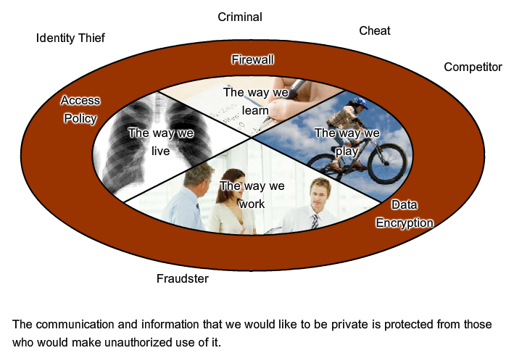
Reliable Network Providing Network Security
Notes:
Section 1.3.2.6

Slide 32
Network Trends New trends
Some of the top trends include:
Bring Your Own Device (BYOD)
Online collaboration
Video
Cloud computing
Notes:
Section 1.4.1.1

Slide 33

Network Trends Bring Your Own Device (BYOD)
Notes:
Section 1.4.1.2

Slide 34
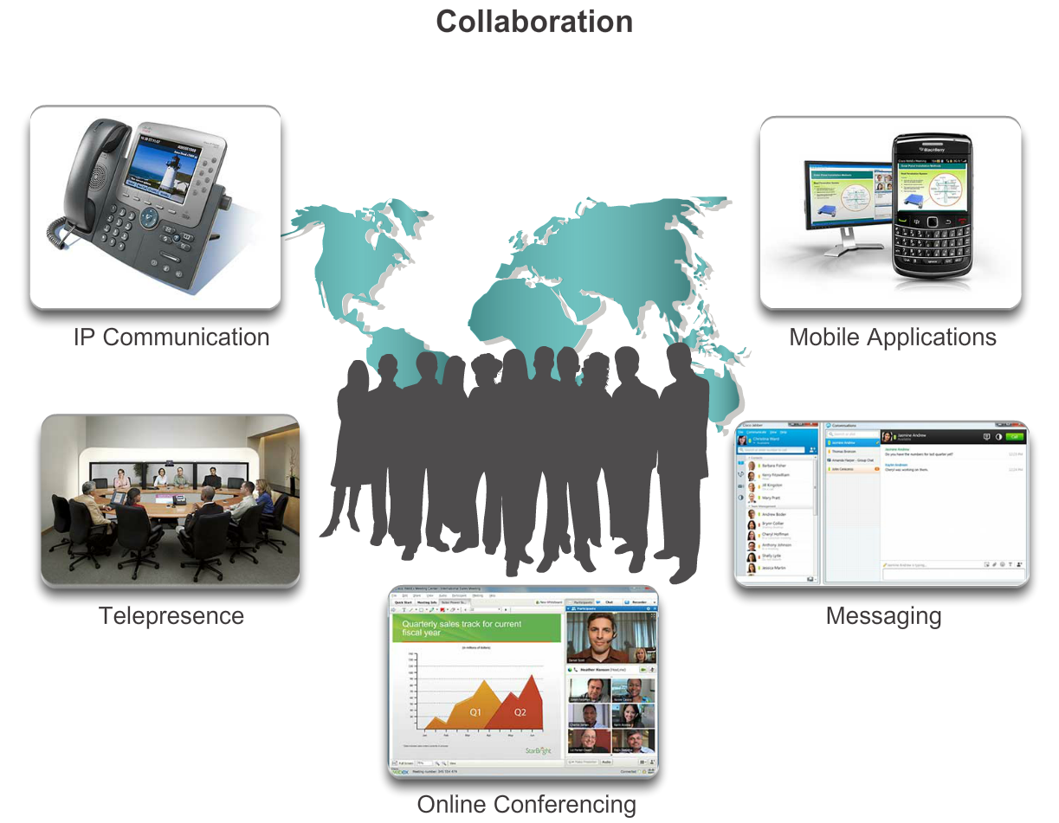
Network Trends Online Collaboration
Notes:
Section 1.4.1.3

Slide 35
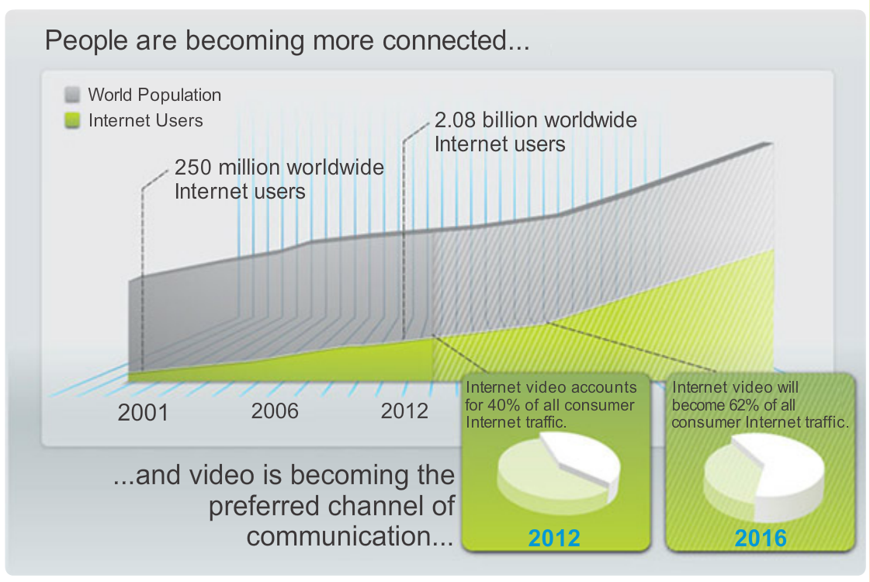
Network Trends Video Communication
Notes:
Section 1.4.1.4

Slide 36
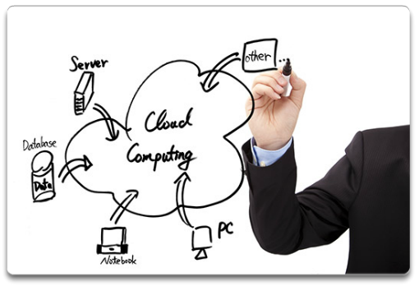
Network Trends Cloud Computing
There are four primary types of clouds:
Public clouds
Private clouds
Custom clouds
Hybrid clouds
Notes:
Section 1.4.1.5

Slide 37
Network Trends Data Centers
A data center is a facility used to house computer systems and associated components including:
Redundant data communications connections
High-speed virtual servers (sometimes referred to as server farms or server clusters)
Redundant storage systems (typically uses SAN technology)
Redundant or backup power supplies
Environmental controls (e.g., air conditioning, fire suppression)
Security devices
Notes:
Section 1.4.1.6

Slide 38
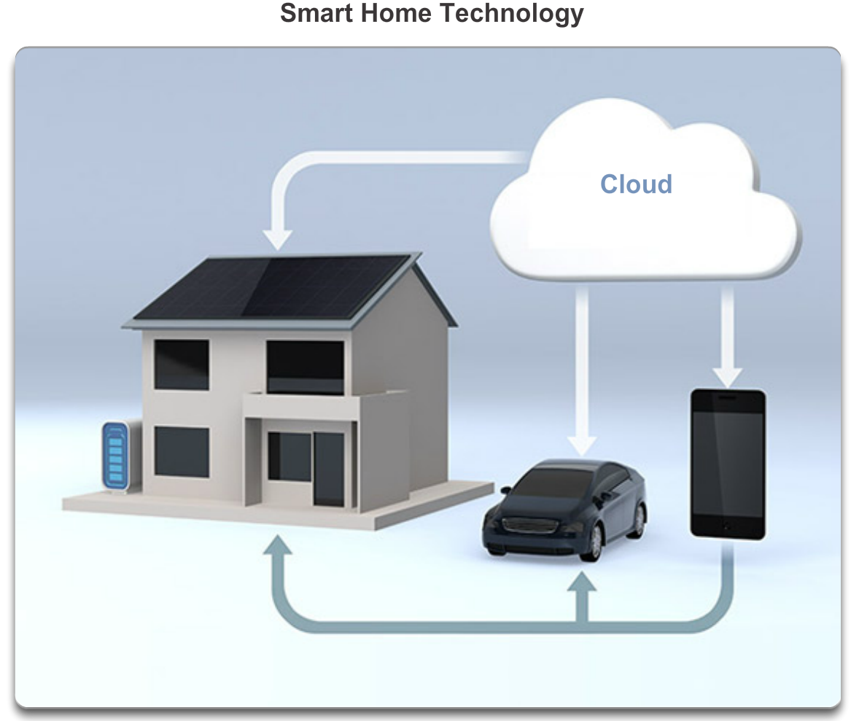
Networking Technologies for the Home Technology Trends in the Home
Notes:
Section 1.4.2.1

Slide 39
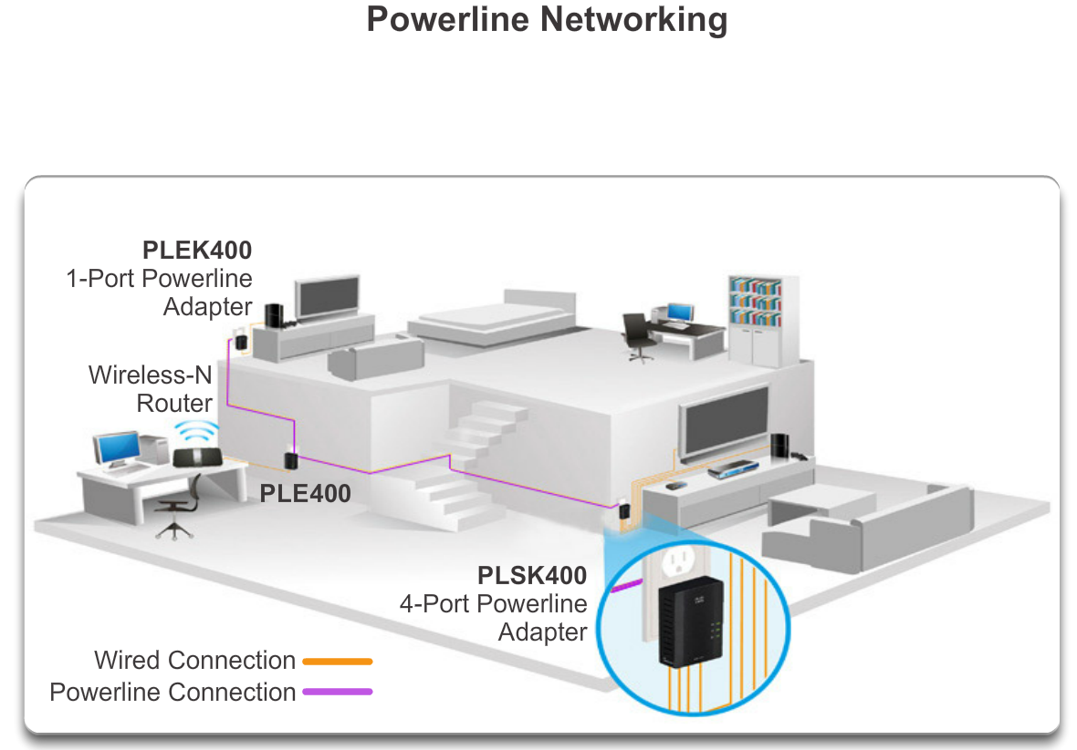
Networking Technologies for the Home Powerline Networking
Notes:
Section 1.4.2.2

Slide 40
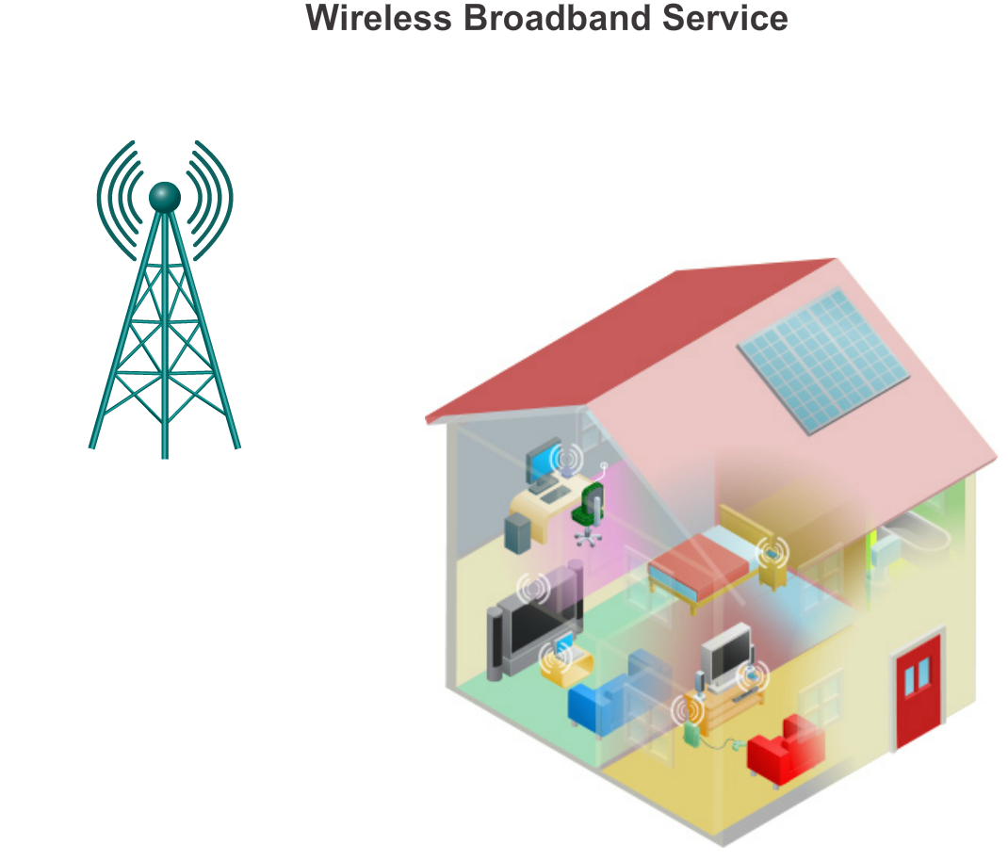
Networking Technologies for the Home Wireless Broadband
Notes:
Section 1.4.2.3

Slide 41
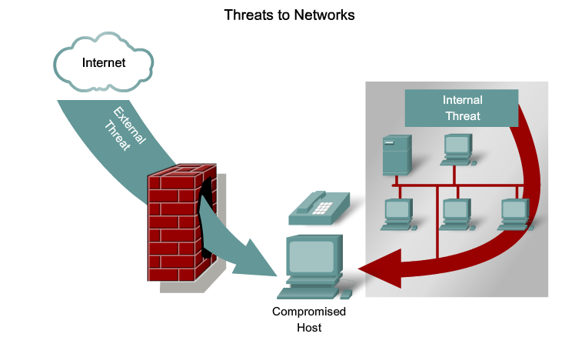
Future of Networking Network Security
Notes:
Section 1.4.3

Slide 42
Network Security Security Threats
The most common external threats to networks include:
Viruses, worms, and Trojan horses
Spyware and adware
Zero-day attacks, also called zero-hour attacks
Hacker attacks
Denial of service attacks
Data interception and theft
Identity theft
Notes:
Section 1.4.3.1

Slide 43
Network Security Security Solutions
Network security components often include:
Antivirus and antispyware
Firewall filtering
Dedicated firewall systems
Access control lists (ACL)
Intrusion prevention systems (IPS)
Virtual Private Networks (VPNs)
Notes:
Section 1.4.3.2

Slide 44
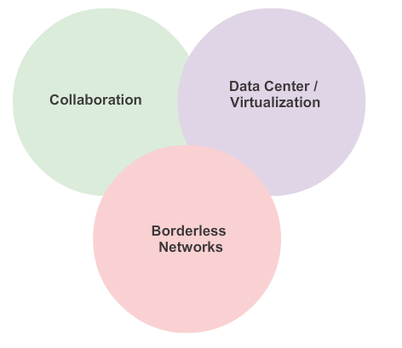
Network Architectures Cisco Network Architectures
Notes:
Section 1.4.4.1

Slide 45
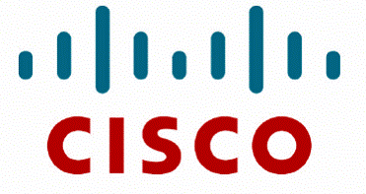
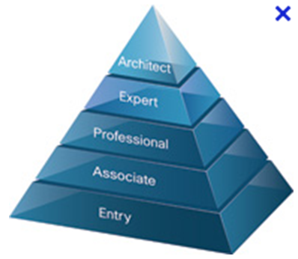
Network Architectures Cisco Certified Network Associate (CCNA)
Notes:
Section 1.4.4.2

Slide 46
Exploring the Networking Summary
In this chapter, you learned:
Networks and the Internet have changed the way we communicate, learn, work, and even play.
Networks come in all sizes. They can range from simple networks consisting of two computers, to networks connecting millions of devices.
The Internet is the largest network in existence. In fact, the term Internet means a ‘network of networks. The Internet provides the services that enable us to connect and communicate with our families, friends, work, and interests.
Notes:
Section 1.5 & 1.5.1

Slide 47
Exploring the Networking Summary
In this chapter, you learned:
The network infrastructure is the platform that supports the network. It provides the stable and reliable channel over which communication can occur. It is made up of network components including end devices, intermediate device, and network media.
Networks must be reliable.
Network security is an integral part of computer networking, regardless of whether the network is limited to a home environment with a single connection to the Internet, or as large as a corporation with thousands of users.
Notes:
Section 1.5 & 1.5.1

Slide 48
Exploring the Networking Summary
In this chapter, you learned:
The network infrastructure can vary greatly in terms of size, number of users, and number and types of services that are supported on it. The network infrastructure must grow and adjust to support the way the network is used. The routing and switching platform is the foundation of any network infrastructure.
Notes:
Section 1.5 & 1.5.1

Slide 49


